Slide 1

EMERGENCY AUTOMOBILE TECHNIAN SERVICE (MACHANIC KOTHAY ? )
GROUP - 07

Slide 2
MEMBERS

Slide 3
CONTENTS
IDEA GENERATION
USE CASE DIAGRAM
ACTIVITY DIAGRAM
USER INTERFACE OR MOCK DESIGN
JIRA
GIT
CLASS DIAGRAM
CODE
PROJECT SCHEDULING
EFFORT ESTIMATION & BUDGETING

Slide 4
IDEA GENERATION

Slide 5
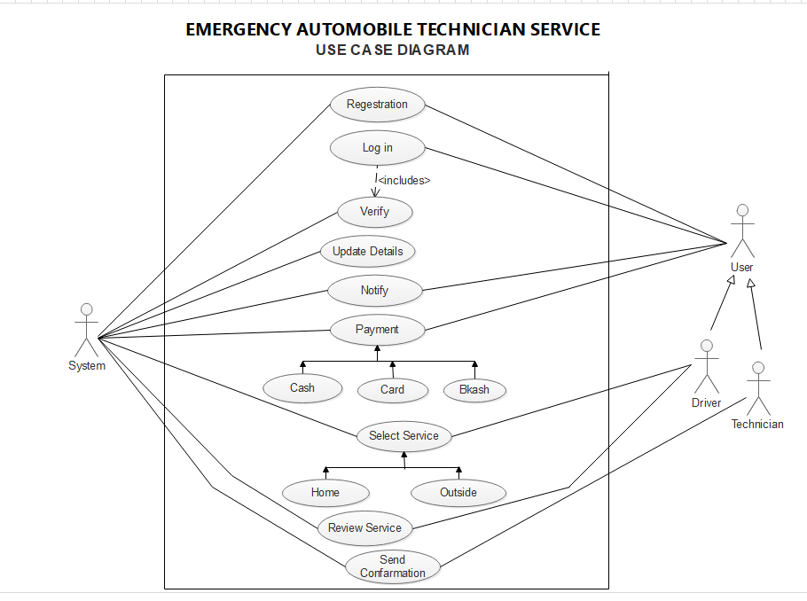
USE CASE DIAGRAM

Slide 6
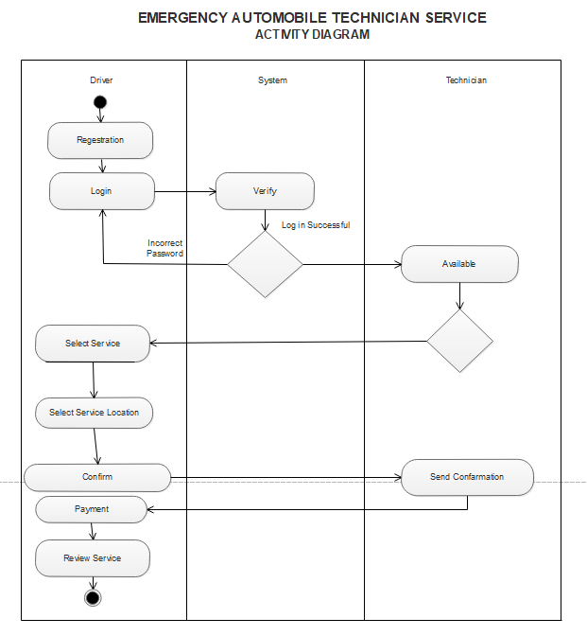
ACTIVITY DIAGRAM

Slide 7
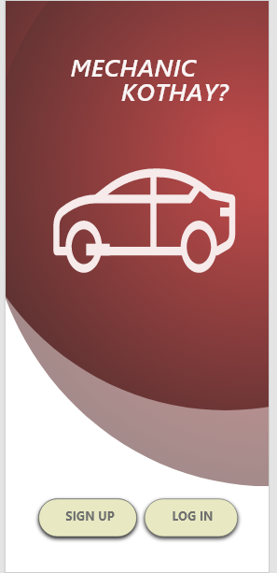
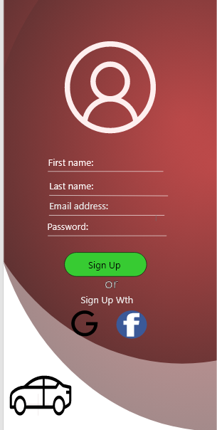
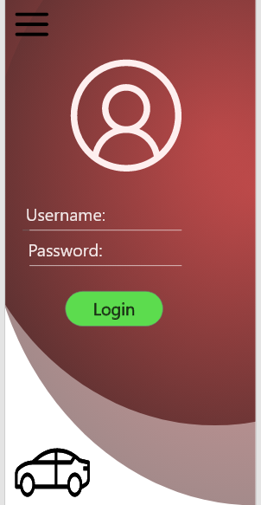
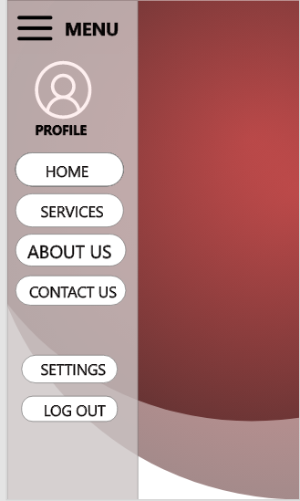
USER INTERFACE OR MOCK DESIGN

Slide 8
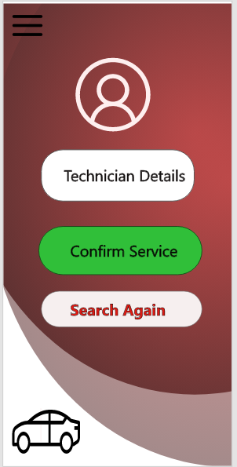
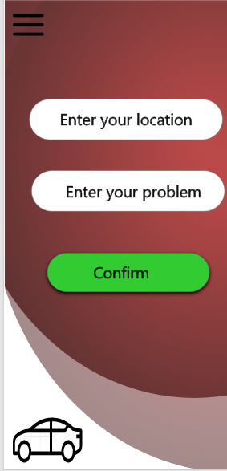
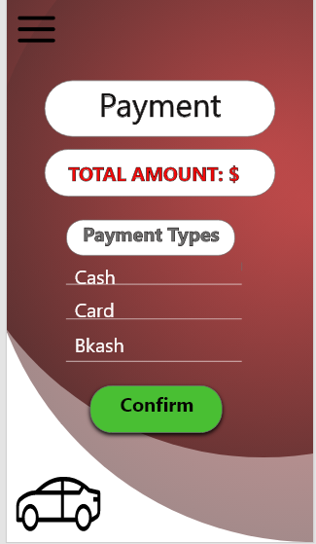
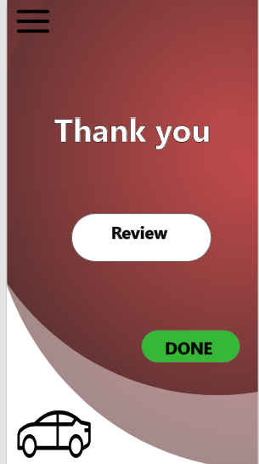
USER INTERFACE OR MOCK DESIGN

Slide 9
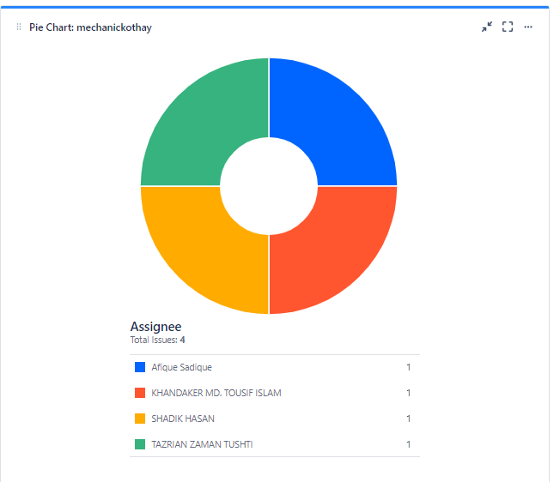
JIRA
LINKS : https://mechanickothay.atlassian.net/secure/Dashboard.jspa?selectPageId=10001

Slide 10
GIT

Slide 11
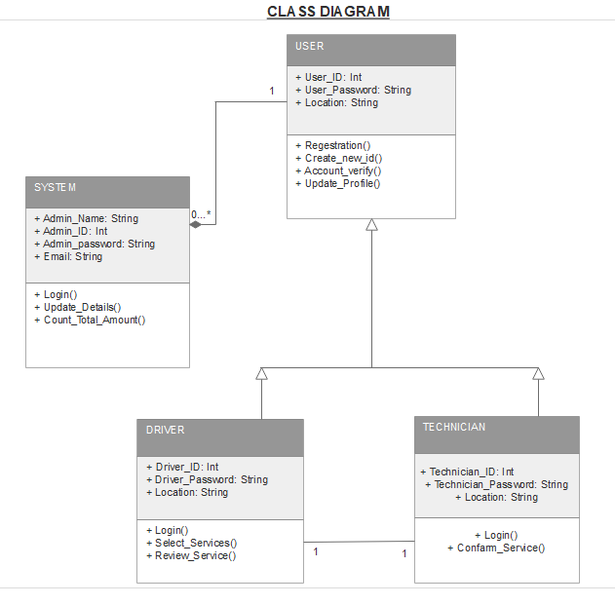
CLASS DIAGRAM

Slide 12
CODE

Slide 13
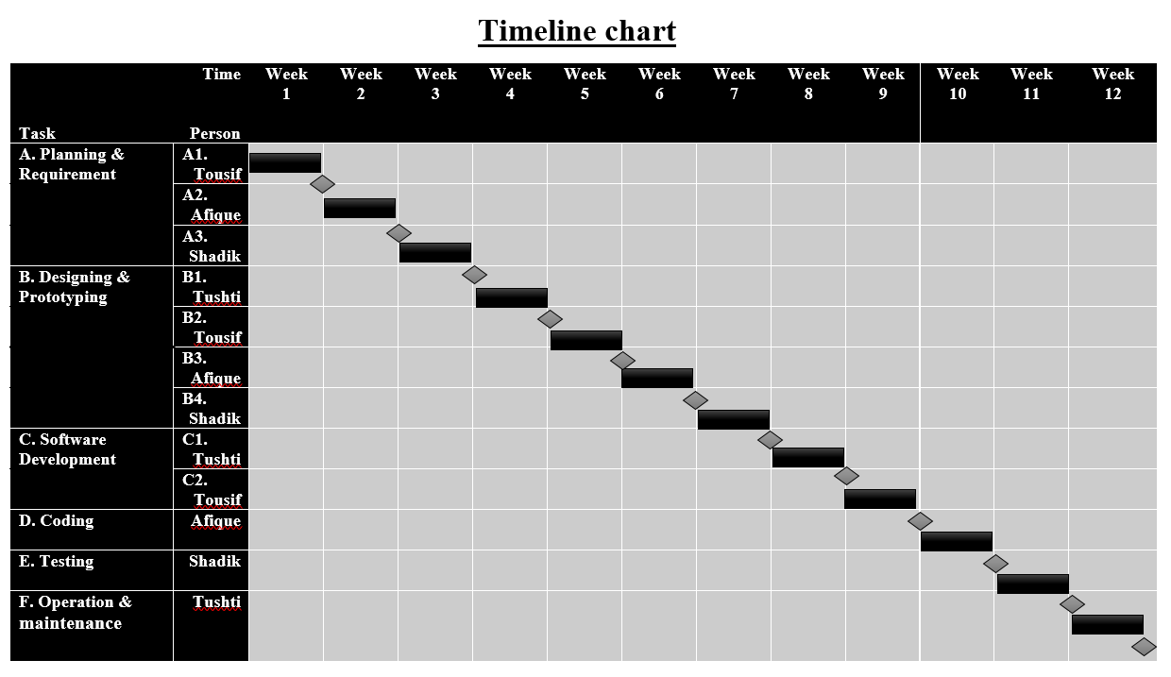
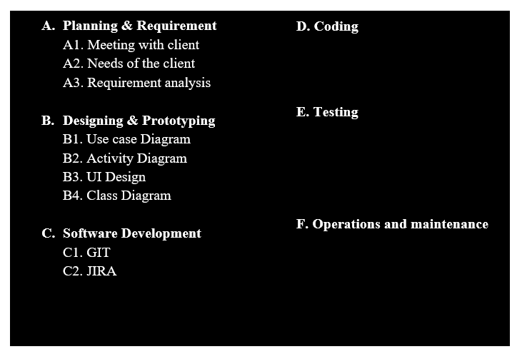
PROJECT SCHEDULING

Slide 14
EFFORT ESTIMATION & BUDGETING
Effort = PM = Coefficient*(SLOC/1000)^P
= 2.4(20000/1000)^1.05
= 55
Development time = DM = 2.50*(PM)^T
= 2.50*(55)^.38
= 11
Required number of people = ST = PM/DM
= 45/11
= 5
Designing & Coding = 11*22*8 [11 month, 22 days , 8h]
= 1936 h
Total sal(day) = 1936*1200 [1h salary =1200tk]
= 2323200 tk [5 day salary] (So, 1 day sal=464640)
Per month salary = (464640/11)
= 42240 tk(1 day)
Requirement Analysis = 15*8*600 [15 days, 600 per h sal]
=72000 tk

Slide 15
EFFORT ESTIMATION & BUDGETING
Maintenance = 2*5*6*2500 [per week 2h, 6mon]
= 150000 tk
Travel Expense = 11*5000
= 55000 tk
Office Rent = 20000*12
= 240000 [per month 20000]
Utilities Expenses = 3500*12
= 42000
Training/Hardware = 3000*12
= 36000
Cost = 2323200 +42240 +72000 +150000 +55000 +240000 +42000
= 2924440 tk
Profit margin = 2924440*15%
= 438666 tk
Pay bill (client) = 33,00000 tk

Slide 16

QUESTION ANSWER SESSION
Anyone has any question about this presentation?

Slide 17


